Slide 1
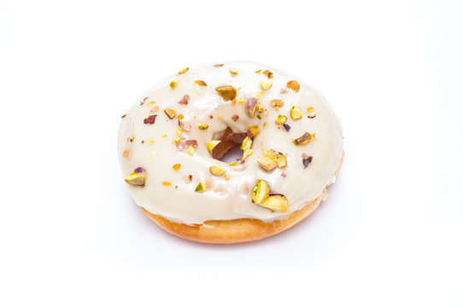
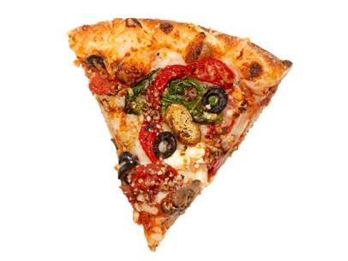
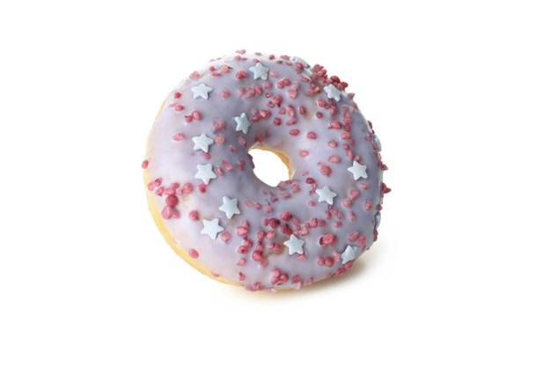
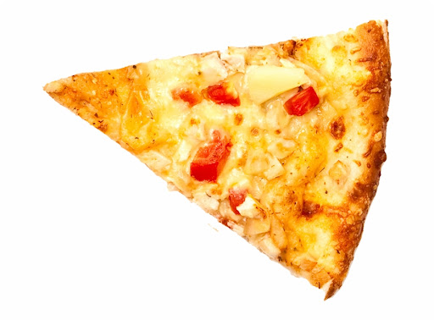

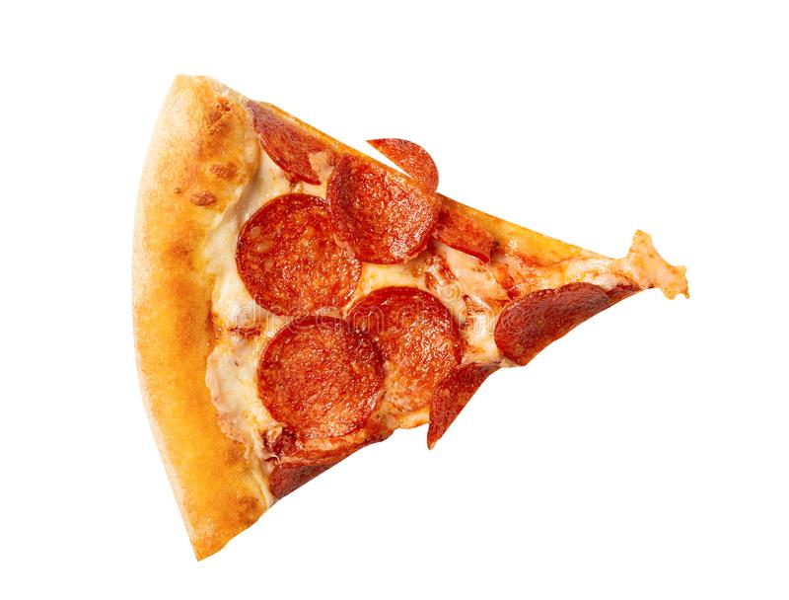
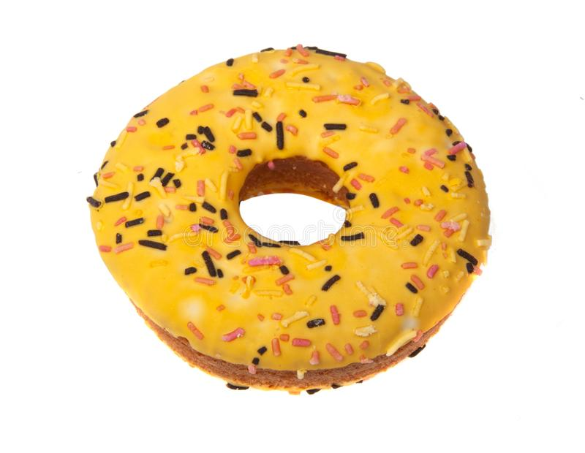
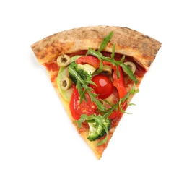
Supervised Learning
Pizza
Doughnut
Doughnut
Pizza
Doughnut
Pizza
Doughnut
Pizza

Slide 2
Unsupervised Learning - clustering

Slide 3
Semi-supervised Learning
Doughnut
Doughnut
Pizza

Slide 4
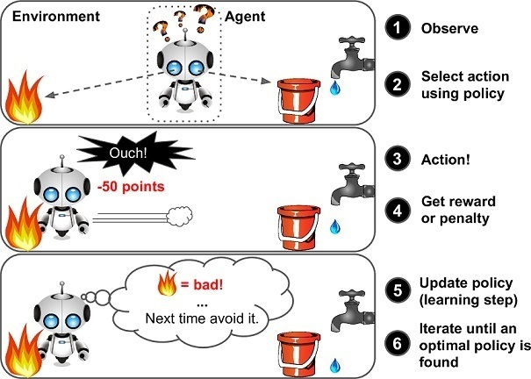
Reinforcement Learning

